Slide 1
Basics of NGS
Under Jayaprakash sir

Slide 2
Objectives
To learn basics of Next Generation Sequencing which includes quality control, adapter trimming, mapping, processing of data
To learn different softwares used for processing of NGS data like Fast QC, STAR aligner
To learn different terminologies and graphs in analysis report generated by different softwares
To plot different graphs for better visualization and interpretation of data
To observe the efficiencies of synthesized primers and error in different process of library preparation

Slide 3
Methods
Use of Fast QC software for quality control step
Preparation of GTF files by plastid and pygtftk package for mapping step
Learning of different commands of STAR aligner for mapping step
Generation of BAM files by using STAR aligner for bulk sequencing and interpretation of its results using featureCounts
Learn difference between bulk sequencing and single cell sequencing
….. to be continued in next slide

Slide 4
Using STAR solo for single cell sequencing
Getting raw count matrix from matrix.mtx using scanpy package
Plotting BC rank plot from raw count
Normalize the raw count matrix using scanpy package
Plot different graphs for better visualization and interpretation of data so as to have an idea about primer efficiencies and interpreting different error possibilities in library preparation

Slide 5
Literature Survey
https://bioinformaticsworkbook.org/dataAnalysis/RNA-Seq/RNA-SeqIntro/RNAseq-intro#gsc.tab=0
https://sampled.com/bulk-rna-sequencing-vs-single-cell-rna-sequencing/#:~:text=So%2C%20Bulk%20RNA%20sequencing%20(bulk,gene%20expression%20in%20individual%20cells.
https://www.biorxiv.org/content/10.1101/770388v3.full

Slide 6
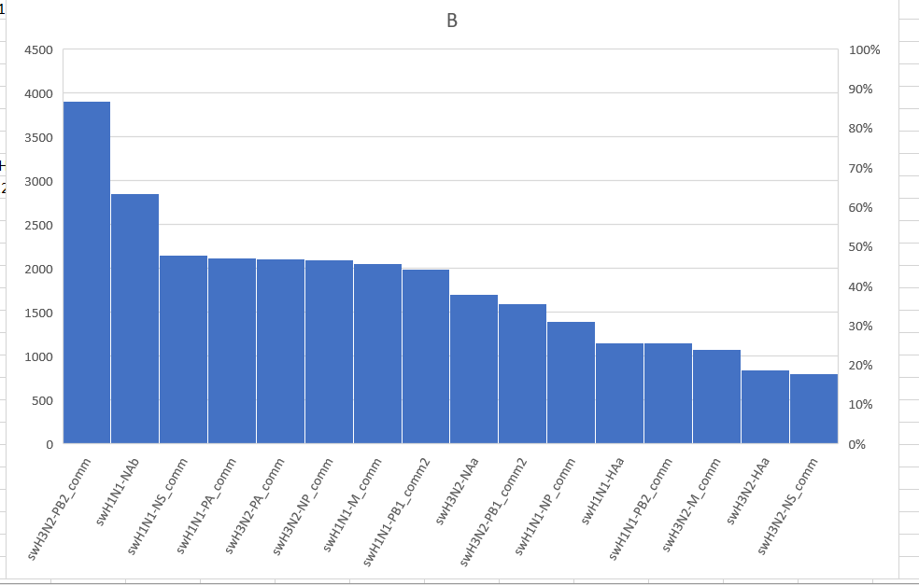

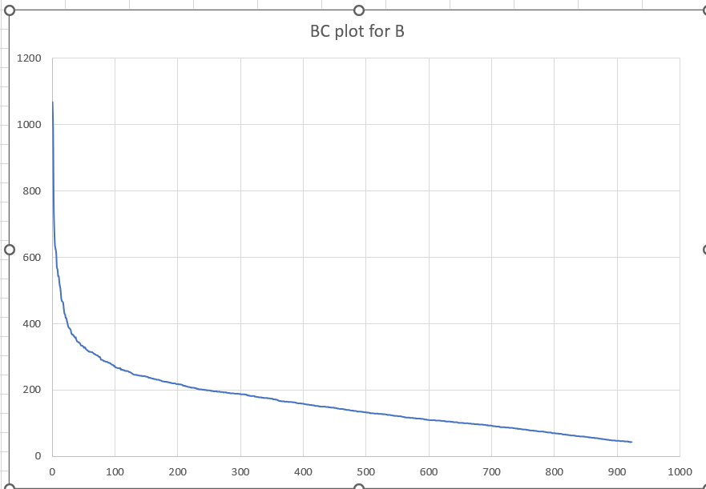

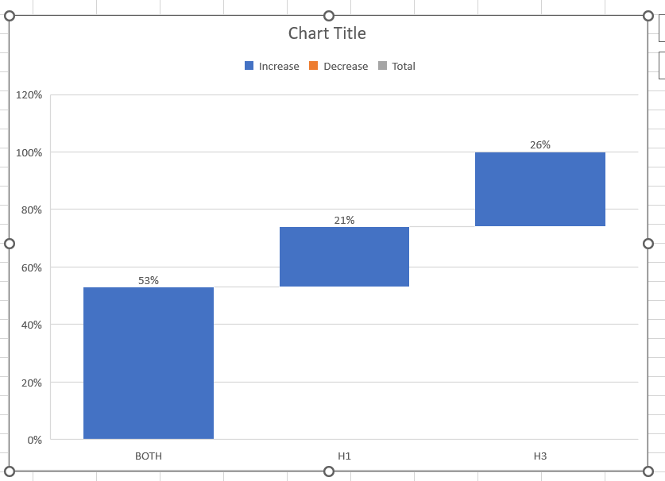
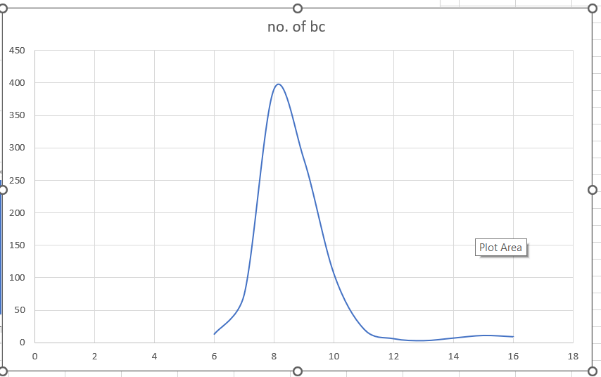
Results
Fig.5
Fig.1
Fig. 4
Fig. 3

Slide 7
Fig. 1 shows BC rank plot for dataset B. From this it can be interpreted that cells expressing more are less in number and vice versa. Hence the normalization process is required to get a uniform expression in all cells.
Fig. 2 shows how many cells are expressing a particular gene. There is homogeneity in expression of a particular gene in both strains which means our primers have similar efficiencies for a particular gene in both strains. This verifies the main aim of the experiment.
Fig. 3 shows distribution of H1, H3 and recombinant strain. The presence of recombinant strain tells us that there is some error in library preparation as reassortment was not allowed in this experiment. The error might be in droplet capturing part or library preparation part.
Fig. 4 represents different no. of UMI from different number of BC. Max number of barcodes have 9 UMIs as interpreted from graph.
Fig. 5 shows how many read correspond to a particular gene.

